Slide 1
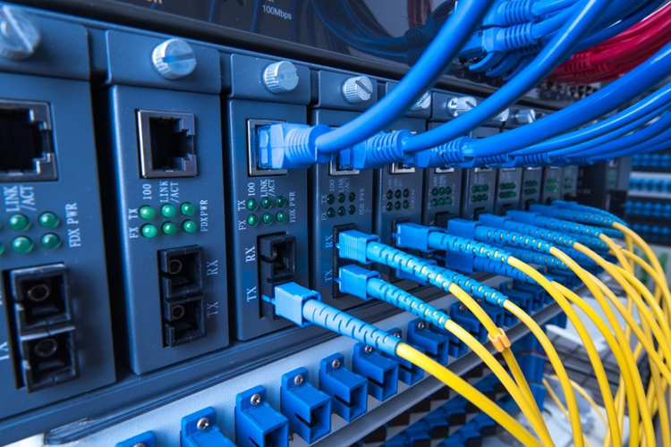
P R E S E N TAT I O N ON REDISTRIBUTION
Presentation by Rujhaan Gupta(20BCS9747)

Slide 2

What is Networking?
Networking, also known as computer networking, is the practice of transporting and exchanging data between nodes over a shared medium in an information system. Networking comprises not only the design, construction and use of a network, but also the management, maintenance and operation of the network infrastructure, software and policies.
Computer networking enables devices and endpoints to be connected to each other on a local area network (LAN) or to a larger network, such as the internet or a private wide area network (WAN). This is an essential function for service providers, businesses and consumers worldwide to share resources, use or offer services, and communicate. Networking facilitates everything from telephone calls to text messaging to streaming video to the internet of things (IoT).
The level of skill required to operate a network directly correlates to the complexity of a given network. For example, a large enterprise may have thousands of nodes and rigorous security requirements, such as end-to-end encryption, requiring specialized network administrators to oversee the network.
At the other end of the spectrum, a layperson may set up and perform basic troubleshooting for a home Wi-Fi network with a short instruction manual. Both examples constitute computer networking.

Slide 3
ROUTING PROTOCOLS
Routing protocols can help computer networks communicate effectively and efficiently. Regardless of network size, these protocols can help securely transfer data to its destination. Understanding the different categories and types is beneficial to understand what routing practice can best address your needs.
There are 3 main different types of protocols:-
1. Routing information protocol (RIP)
RIP, an interior gateway protocol, is one of the first protocols created. You can use it with local area networks (LANs), which are linked computers in a small range, or wide area networks (WANs), which are telecommunications networks that cover a greater range. There are two different versions of this protocol
2. Enhanced interior gateway routing protocol (EIGRP)
Cisco also developed EIGRP, which allows for 255 hops. This type classifies as a distance vector, interior gateway and classless protocol. It uses the reliable transport protocol and the diffusing update algorithm to speed up the data convergence process, which maximizes efficiency. When in use, a router can take information from other routers' tables and record them as references. If a change occurs, each router notifies its neighbor to help ensure they all know which data routes are in use. This helps prevent potential miscommunications between routers.

Slide 4
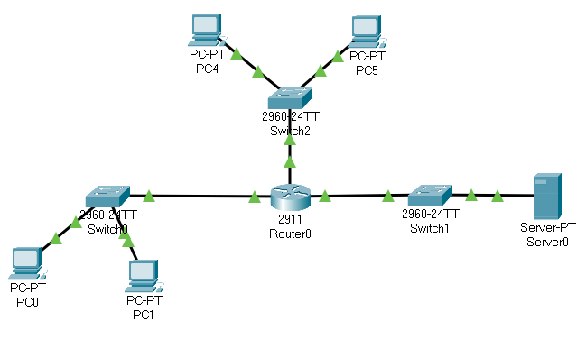
3. Open shortest path first (OSPF) OSPF—which classifies as a link state, interior gateway and classless protocol—uses the shortest path first (SPF) algorithm to ensure the efficient transmission of data. Internally, this type maintains multiple databases with topology tables and information about its entire network. Typically, the information comes from link state advertisements sent by individual routers. The advertisements, which are like reports, share detailed descriptions of the path's distance and how many resources it may require. OSPF uses an algorithm called Dijkstra to recalculate pathways when topology changes occur. It also uses authentication practices to ensure its data is secure throughout changes or network breaches. Small and large network organizations may benefit from using OSPF because of its scalability features.
fds

Slide 5


TECHNOLOGY
USED
1.SOFTWARE USED:
1.CISCO PACKET TRACER
2.HARDWARE USED:
RAM (4GB OR ABOVE)
PROCESSOR(I3 5TH GEN OR ABOVE)
SYSTEM TYPE (32 OR 64 BIT)
3. PACKET TRACER TOOLS
1.END DEVICES (SERVER, PC, WIFI)
2. ROUTER(2811) AND SWITCH(2960)
3. SERIAL CABLE AND STRAIGHT CABLE

Slide 6
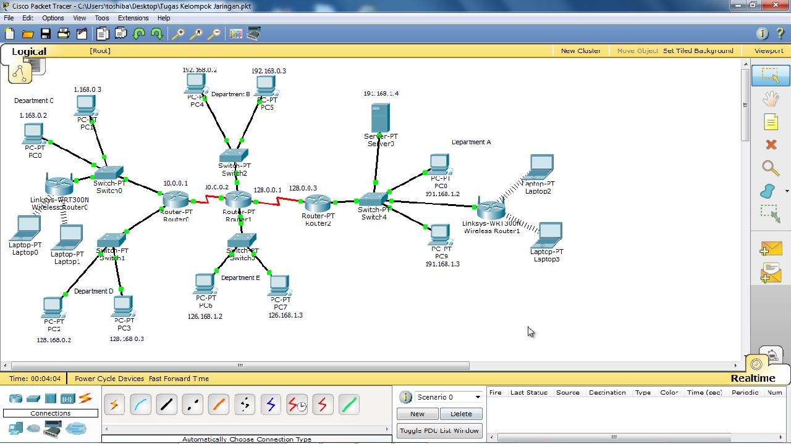
CISCO PACKET TRACER
Cisco® Packet Tracer is a powerful network simulation program that allows students to experiment with network behavior and ask “what if” questions. As an integral part of the Networking Academy comprehensive learning experience, Packet Tracer provides simulation, visualization, authoring, assessment, and collaboration capabilities to facilitate the teaching and learning of complex technology concepts. Packet Tracer supplements physical equipment in the classroom by allowing students to create a network with an almost unlimited number of devices, encouraging practice, discovery, and troubleshooting. The simulation-based learning environment helps students develop 21st century skills such as decision making, creative and critical thinking, and problem solving.

Slide 7
REDISTRIBUTION
It is a process of advertising a route learned by method of static routing, directly connected route or a dynamic routing protocol into another routing protocol. Here, router2 one interface (fa0/0) is running EIGRP and other interface(fa0/1) is running OSPF then we have to advertise the routes of OSPF into EIGRP and vice-versa so that the routes learned by these routing protocols are advertised with each other. This process is called redistribution. Otherwise, the router1 will not be able to learn routes of router3 and router3 will not be able to learn routes of router1.
Metric – As we know, different routing protocols use different metrics to find out best path therefore when we redistribute route from one routing protocol to another, we have to define metric which should be understandable by the routing protocol.
Where metric 1 means hop count 1 while EIGRP 1 means autonomous system 1.
Configuration –
Redistributing into RIP - RIP is a standardized Distance-Vector routing protocol that uses hop-count as its distance metric. Consider the following example: RouterB is our
redistribution point between IGRP and RIP.
To redistribute all IGRP routes into RIP:
Router(config)# router rip
Router(config-router)# network ip address
Router(config-router)# redistribute eigrp (process id) metric 1
router(config)router rip
router(config-router)#redistribute Eigrp 1 metric 1

Slide 8
Redistributing into EIGRP - EIGRP is a Cisco-proprietary hybrid routing protocol that, by default, uses a composite of bandwidth and delay as its distance metric. EIGRP can additionally consider Reliability, Load, and MTU for its metric.
To redistribute all OSPF routes into EIGRP:
Router(config)# router eigrp (process id)
Router(config-router)# network (ip address) wild card mask
Router(config-router)# redistribute ospf (area) metric 1 100 100 100 100
Next, EIGRP was configured to advertise the network of 10.1.2.0/24. Finally, EIGRP was configured to
redistribute all ospf routes from processID 20, and apply a metric of 10000 (bandwidth), 1000 (delay), 255 (reliability), 1 (load), and 1500 (MTU) to the redistributed routes.
It is possible to specify a default-metric for all redistributed routes:
Router(config)# router eigrp (process id)
Router(config-router)# redistribute ospf (area)
Router(config-router)# default-metric 10000 1000 255 1 1500
Redistributing into OSPF - OSPF is a standardized Link-State routing protocol that uses cost (based on bandwidth) as its link-state metric. An OSPF router performing redistribution automatically becomes an ASBR.
To redistribute all EIGRP routes into OSPF:
Router(config)# router ospf 20
Router(config-router)# network (ip address) (wild card mask)area 0
Router(config-router)# redistribute eigrp 15
Router(config-router)# default-metric 30

Slide 9
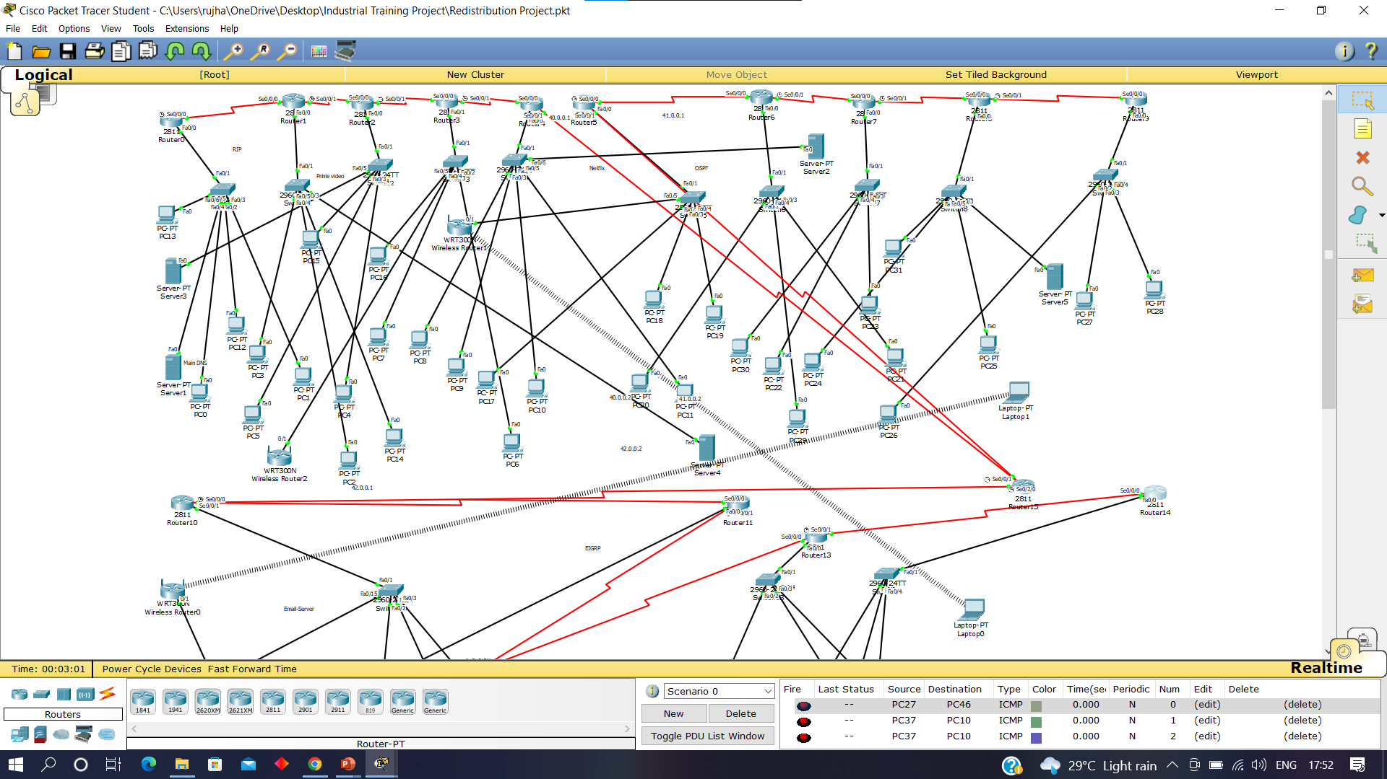

Slide 10


